Slide 1
Team Based Learning
Presented By: Yvette Heasley
Frazier Mountain High School
ComTec Academy

Slide 2
Four Components of Team Based Learning
Teams: must be properly formed and managed
Accountability: students must be accountable for the quality of their individual and team work
Feedback: must be timely and frequent
Assignment Design: team assignments must promote both learning and team development
Source: Micaelson, Larry: Team Based Learning: Small-Group Learning’s Next Big Step

Slide 3
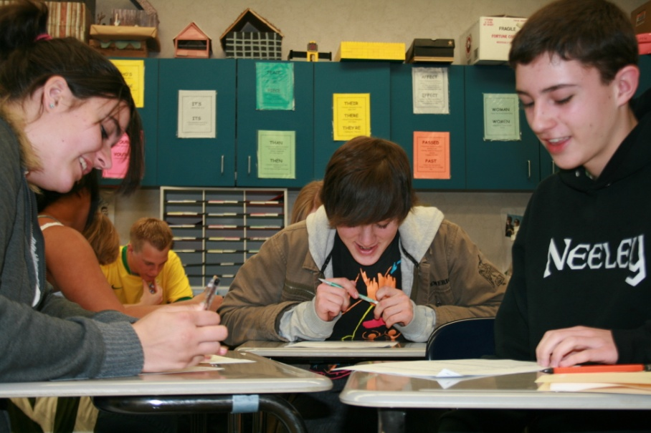
Why Team Based Learning?
“TBL is more about learning rather than getting a good grade – which is what education is supposed to be about.” - Amelia N.
Real-World Learning Techniques
Accountability – Student and Teacher
Immediate Feedback and Review
Improves Attendance and Preparedness
Instructs Discernment and Negotiation
Promotes Collaborative and Social Experiences
Classroom Management
Improves Assessment and Data Analysis
Students Own and Embrace Learning

Slide 4
Real-World Learning
Why do we isolate student learning?
Shouldn’t learning be a collaborative endeavor?
How do each of us work in the real world?
Students should be prepared for real-world experiences.
“The TBL process was a good process that allowed the student to get a better chance at learning the material because we could talk it over with a teammate.” – Paul C.

Slide 5
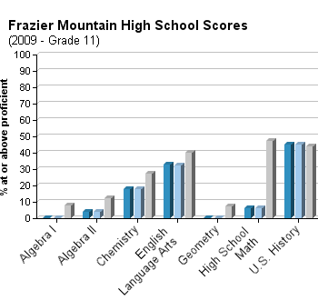
Accountability
Students are accountable to themselves and to their teammates.
Teachers are accountable to students through written appeals.
Assessments and assignments are written to reflect CA Content Standards and Expected Schoolwide Learning Results.
“Our team was great! We always got high scores on tests and got along doing it. We made sure there was a good reason to pick the answers we picked and, if we were wrong, we were all wrong.”
- Jason R.

Slide 6
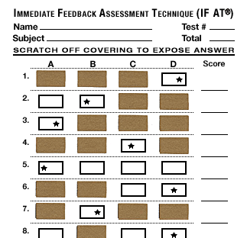
Immediate Feedback and Review
“The TBL Process, I feel, is a good process. It gives the students a chance to discuss the questions and to have a better understanding of the test questions. This process helps students realize their mistakes and the appeals process is especially nice to have.”
– Jackie H.
IF-AT Assessment Form (Immediate Feedback Assessment Technique)
Immediate Review of Correct Answers
Allows Students to Avoid the “Deeper Hole”
Alleviates Class Time for Review
Directed Feedback via Written Appeals

Slide 7
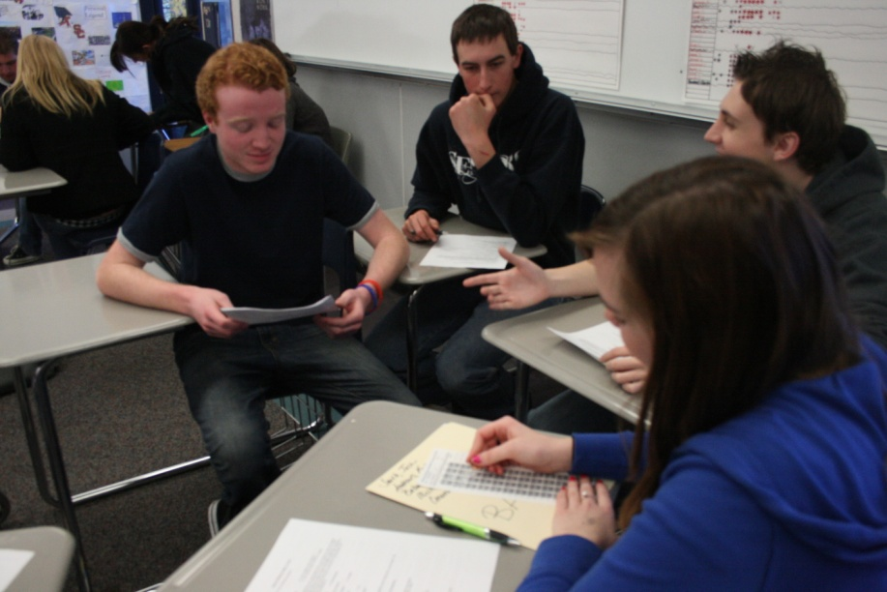
Improves Attendance and Preparedness
Attendance is mandatory on test day in order to qualify for team grade.
Students prepare for assessment and discussion that will take place on team day or suffer negative evaluation.
Students are often more motivated by fellow students than their instructor.
“Some positives would be that you have a lot better chance of passing. Also, I got a lot happier when getting a question right. Some negatives would be that some members have attendance problems.”
– Mike T.

Slide 8
Instructs Discernment and Negotiation
“I definitely prefer this style of learning. I didn’t like it at first, but once I got more involved in the program, I felt more comfortable. If I made mistakes, I was always able to understand the error that I made through my team.” – Meagan W.
Questions are structured so students will think critically and carefully about their choices.
Students learn to form arguments in order to persuade teammates.
Students listen to other perspectives and concede their own and others’ points of view.
Students form supportable arguments for the written appeals process.
Students are reflective regarding personal performance and the performance of teammates.

Slide 9
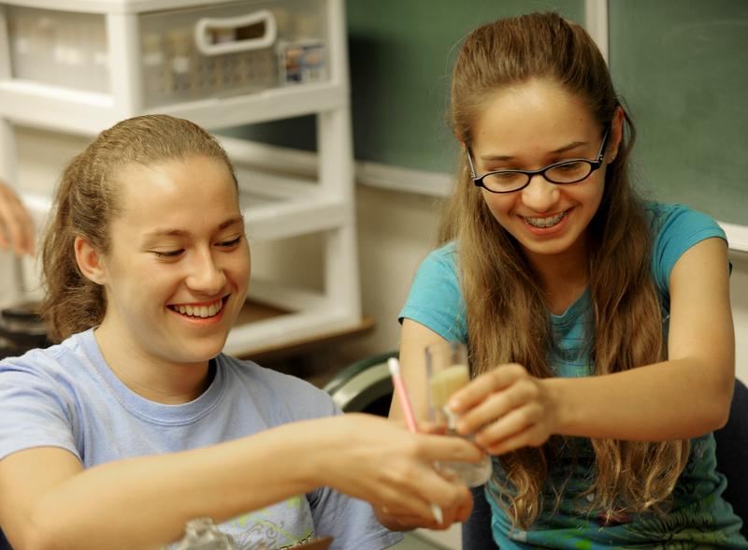
Promotes Collaborative and Social Experiences
Students develop relationships in their teams with each member contributing.
Students learn to discuss their point of view openly and listen to others’ perspectives.
Students succeed or fail together.
Students provide critical analysis of each other’s work through assessments and peer reviews.
“I really liked the way we could all work together to find the right answer. It helped me discuss my answer, which I thought was right, and then be open-minded about other answers. It created a really good listening and discussing experience. It also gave the Academy that ‘separating’ difference.” - Ariel H.

Slide 10
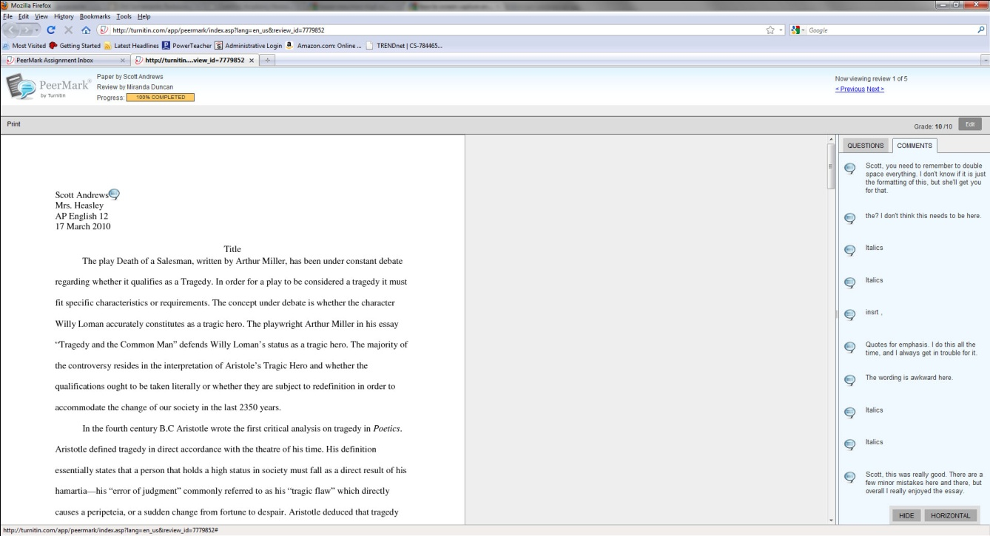
Classroom Management
“I especially liked the peer essay reviews, they definitely helped me rework my essay.” – Scott A.
Allows for personal attention despite class size.
Team mentality provides a “we’re in this together” bond.
Feedback from multiple sources helps with time management.
Allows instructor to be a coach.
Notes:
Social support base for “At-Risk” students
- Building and maintaining enthusiasm for teaching

Slide 11
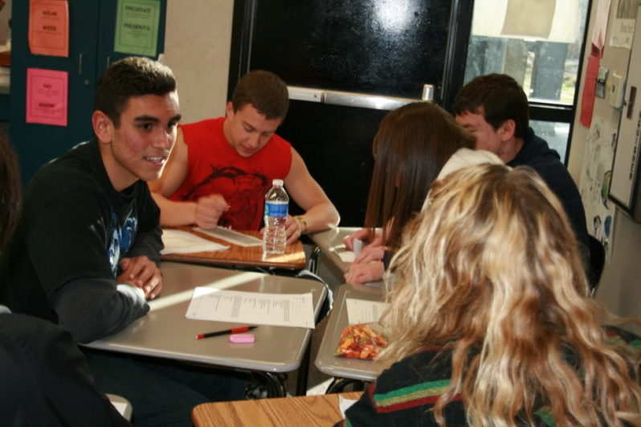
Improve Assessments and Data Analysis
“I enjoyed this learning process immensely. I believe my scores were able to rocket up because of this program and I was also able to understand a lot more of the answers. It felt good to look at questions that I would be unsure about by myself and find out that either I was right, or my peers had the same misgivings as I did . . . not only do I think TBL improved our team’s grades, but it let us understand the questions and answers through discussion.” - Robert M.
Student evaluation of test questions.
Team scores logged on TRAT Tracker.
Data collection and analysis.

Slide 12
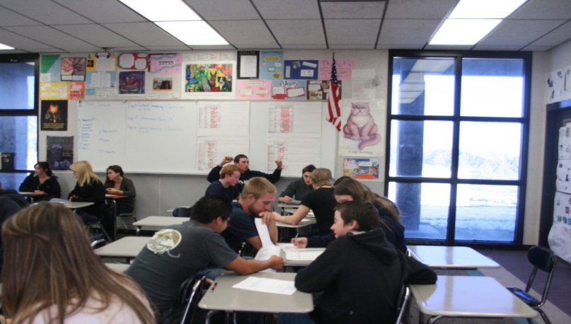
Students Own and Embrace Learning
“I really like the Team Based Learning, it gives you the chance to improve your grade and to bond with other students.” – Katelyn C.
Students recognize that they get from their teams what they contribute.
Returns the element of fun to the learning experience.
Creates personal investment in learning.
“The Team Based Learning process has some great benefits. I like that, when writing an essay, the people in our group can give us feedback to help us get a better grade. Also, I like being able to take a test with a team to either help improve the score or to go over the material again. I really like this style of learning.” – Katie S.

Slide 13
Students Own and Embrace Learning

Slide 14
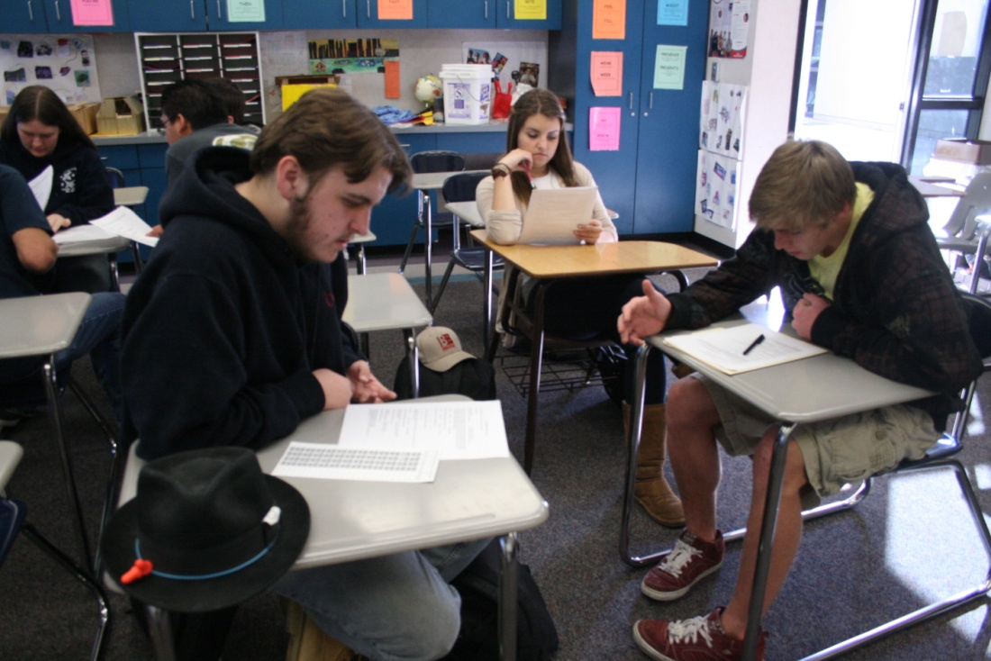
What Can Go Wrong?
Failure to create and manage productive teams.
Only doing some parts of the idea
Without Peer Evaluation it is not TBL
Not obtaining student “Buy-In”
“I like this way of learning – it helps me learn better. It is also kind of fun, so it works great.” – Calvin K.

Slide 15
Team Quiz
1. Which is NOT one of the four components of TBL?
A. Instructor Feedback B. Teams C. Accountability D. Assignment Design
2. IF-AT stands for
A. Immediate Feedback Assessment Technique B. Immediate Feedback Assessment Test
C. Interest Feedback Assessment Test D. Individual Feedback Assessment Technique
3.Student appeals provide feedback for
A. Student Improvement B. Administrators C. Teams D. Instructors
4. Student appeals must be
A. presented orally B. in essay form C. in written form D. written and oral
5. Teams should be established for
A. at least a semester B. each unit C. one month periods D. the entire year
6. TBL promotes
A. communication B. negotiation C. collaboration D. all of these
7. Appeals assist students in learning to
A. collaborate B. create valid arguments C. question authority D. all of these
8. Peer reviews reinforce
A. collaboration B. student involvement C. argumentation D. negotiation
9. In order to receive the team grade, students must score ___ on the individual exam?
A. 60% B. 70% C. 80% D. 90%
10. TBL brings ___ back to learning.
A. fun B. responsibility C. accountability D. frustration

Slide 16
Useful Resources
Michelson, Larry K. et al. Team-Based Learning: Small-Group Learning’s Next Big Step. Number 116, Winter 2008.
Team Based Learning website: http://tblc.camp9.org/
Plethora of information and links to assist in building a TBL classroom
Turnitin.com: online plagiarism and feedback site.
Epstein Educational Enterprises: http://www.epsteineducation.com/home/
Source for IF-AT scratchers and Test Maker

